Slide 1
HCL technologies INTERNSHIP
MACHINE LEARNING
TOPIC: heart disease prediction AND REPORTING
NAME : m chidanand
REG NUMBER : 39110575

Slide 2
SCOPE:
Heart-related diseases or Cardiovascular Diseases (CVDs) are the main reason for a huge number of death in the world over the last few decades and has emerged as the most life-threatening disease, not only in India but in the whole world
Prediction of occurrences of heart diseases in the medical field is significant work. Data analytics is useful for prediction from more information and it helps the medical center to predict various diseases.
The objective of this study is to effectively predict if the patient suffers from heart disease. The health professional enters the input values from the patient's health report. The data is fed into model which predicts the probability of having heart disease

Slide 3
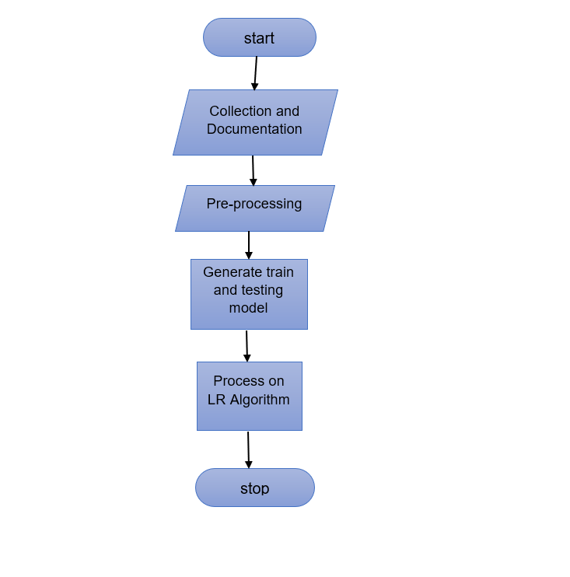
Flow diagram or Ideation map

